Slide 1
Title: Telecommunication Industry
Model development and deployment Approach in Python
by:-PUJA MEHTA
Date:19-06-2024

Slide 2
Abstract:
Title: “Unlocking Growth Opportunities in Telecommunication: A Data-Driven Approach”
In the dynamic telecommunication industry, data-driven insights play a pivotal role in strategic decision-making. As a seasoned analyst, your task is to evaluate TellCo, an existing mobile service provider in the Republic of Pefkakia, and determine its potential for growth.
Abstract: TellCo, a system-generated data-rich telecom company, presents a unique investment opportunity. Leveraging historical customer data, we delve into usage patterns, demographics, and service preferences. Our analysis reveals key insights:
Segmentation: By categorizing users based on behavior and demographics, we identify high-value customer segments.
Churn Prediction: Predictive models help anticipate customer churn, allowing targeted retention efforts.
Revenue Optimization: Analyzing call patterns, data usage, and service subscriptions uncovers revenue-enhancing strategies.
Network Performance: Assessing network quality ensures optimal service delivery.
Our findings will be presented through an intuitive web-based dashboard and a comprehensive written report. Join us on this data-driven journey to unlock TellCo’s growth potential.

Slide 3
1. Introduction:
Unlocking Growth Opportunities in Telecommunication: A Data-Driven Approach
Welcome, esteemed colleagues and investors! Today, we embark on an exciting journey into the heart of the telecommunication industry. Our focus? TellCo—a mobile service provider with untapped potential.
The Investor’s Quest
Our wealthy investor seeks undervalued assets, and their due diligence is meticulous. They recognize that data holds the key to understanding business fundamentals and driving profitability. Our mission? Uncover hidden gems within TellCo’s system-generated data
Past Success: A Blueprint
Drawing from our past success—where we transformed a delivery company by targeting hungry university students—we know that strategic focus matters. By analyzing patterns, we achieved a 25% profit surge. Now, we apply this blueprint to TellCo.
TellCo: The Opportunity
TellCo’s owners have shared financial data, but no one has explored the goldmine of system-generated insights. Our task? Evaluate growth prospects. Through rigorous analysis, we’ll recommend whether to buy or sell. Our findings will be accessible via an intuitive web dashboard and a comprehensive written report.

Slide 4
2.Objectives:
The objective of this analysis is to comprehensively understand and enhance user experiences and satisfaction in the telecom sector through detailed exploratory data analysis (EDA), user engagement metrics, and user experience evaluations.
Task 1: User Overview Analysis focuses on profiling customers by identifying the most popular handsets and manufacturers. Key insights are derived from usage patterns of various applications, covering session counts, durations, data consumption, and volume metrics, while addressing data gaps and outliers.
Task 2: User Engagement Analysis assesses customer engagement by evaluating session frequencies, durations, and total data traffic. Users are segmented into engagement clusters using normalized metrics and k-means clustering, with further insights into top users per application and optimized cluster values derived through the elbow method.
Task 3: User Experience Analytics evaluates network performance and handset characteristics. Aggregated metrics include TCP retransmission, RTT, and throughput, informing clustering analyses that segment users based on experience levels.
Task 4: Satisfaction Analysis integrates engagement and experience scores to predict user satisfaction through regression modeling, clustering, and final score aggregation, culminating in the export of comprehensive user data to a MySQL database and deployment tracking of predictive models.
This analysis enables targeted marketing, resource optimization, and enhancement of user satisfaction in telecom services, driving strategic decision-making for improved customer experiences and operational efficiencies.

Slide 5
3. Methods:
User Overview Analysis
Top 10 Handsets Used by Customers:
Visual representation of the most popular devices.
Top 3 Handset Manufacturers and Top 5 Handsets per Manufacturer:
Charts showcasing leading manufacturers and their top models.

Slide 6
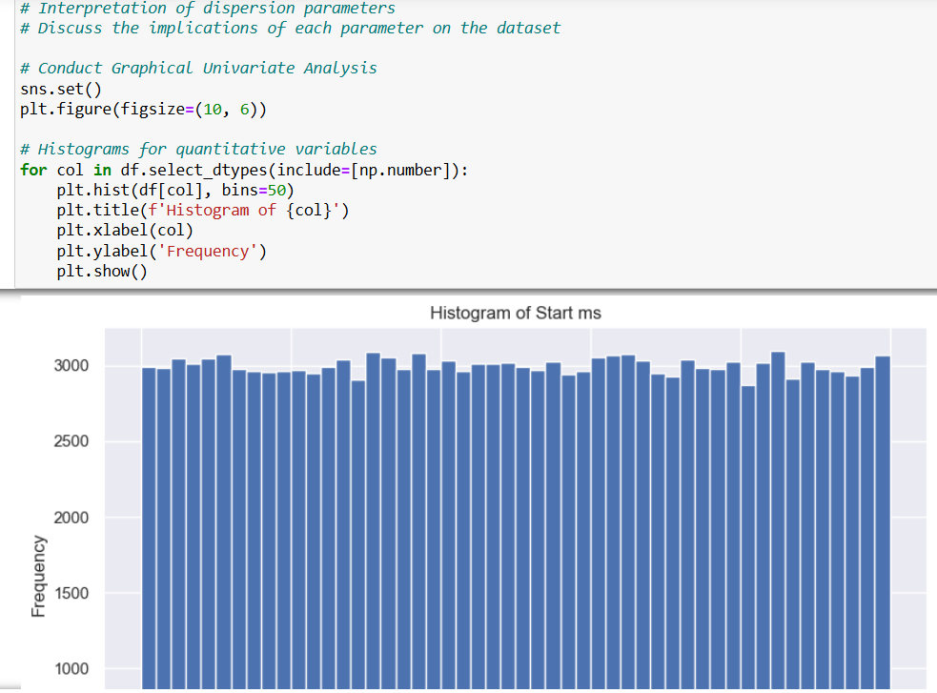

Slide 7
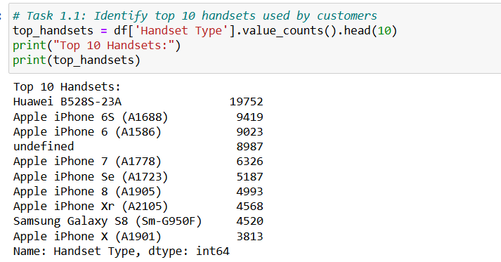
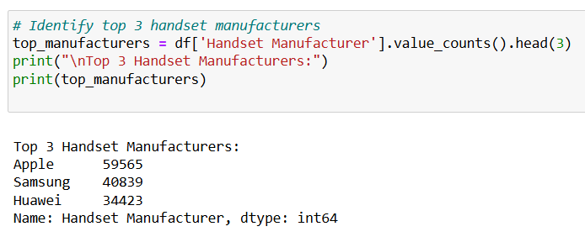

Slide 8
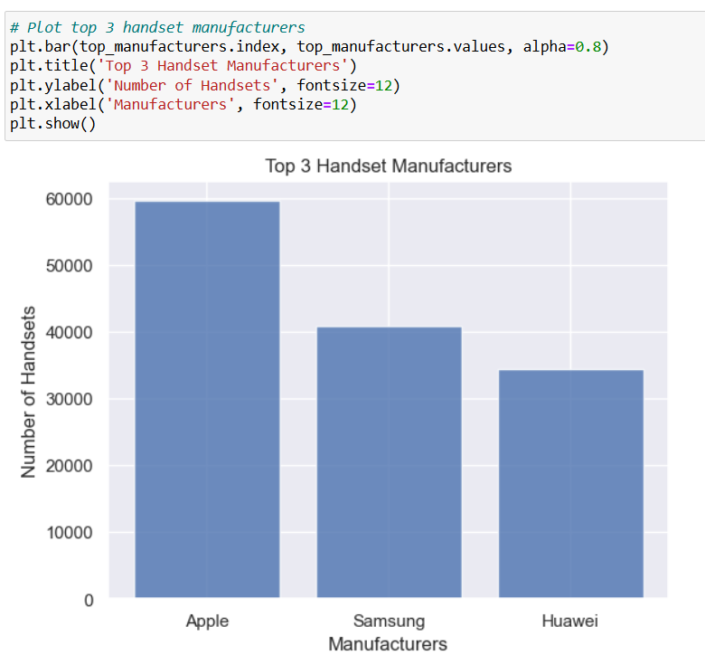

Slide 9
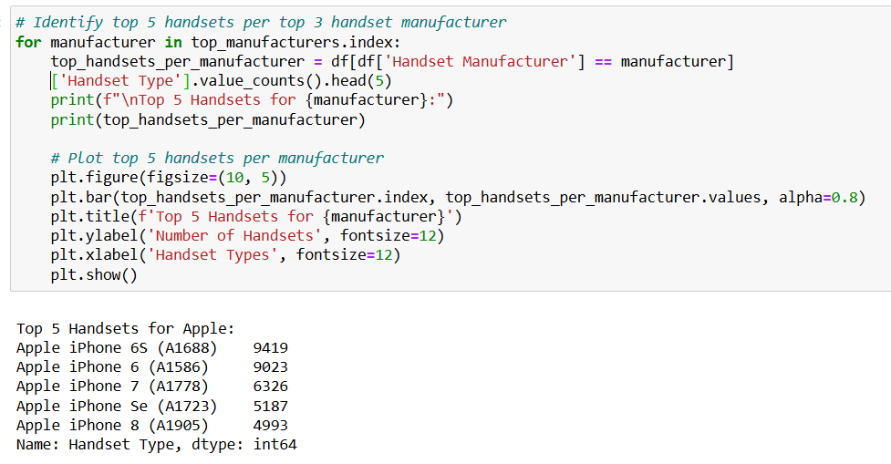
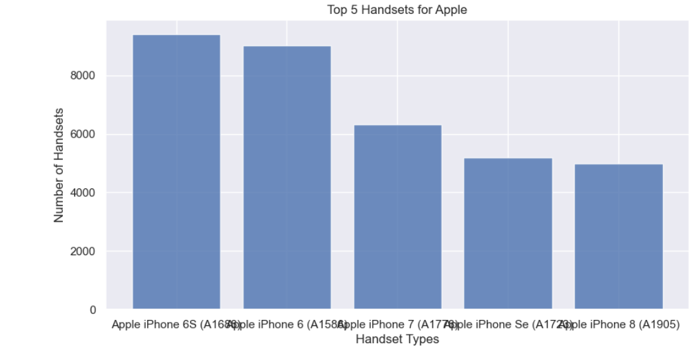

Slide 10
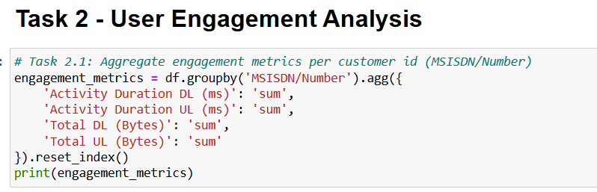
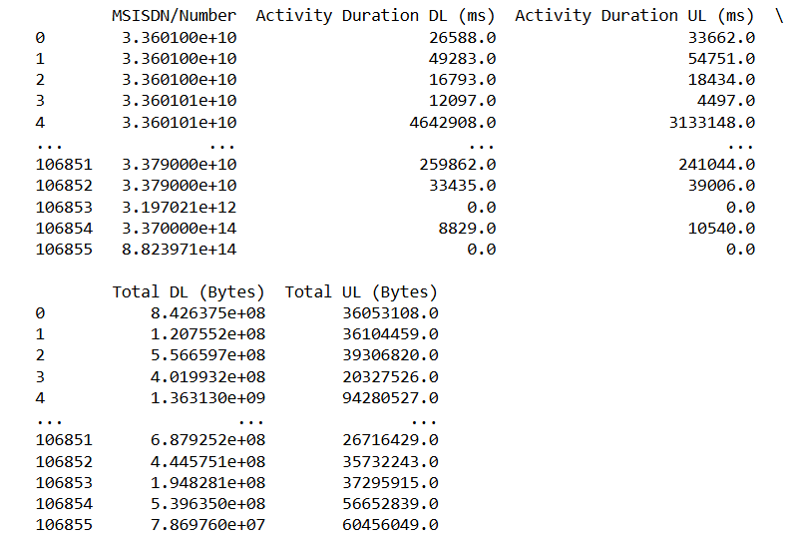

Slide 11
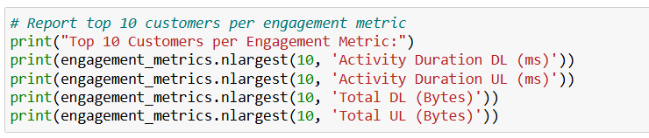
User Engagement Analysis
Top 10 Customers by Engagement Metrics: Tables and charts.
K-means Clustering for Engagement: Visualization of clusters and metrics per cluster.
Top Users per Application: Application-specific user engagement insights.

Slide 12
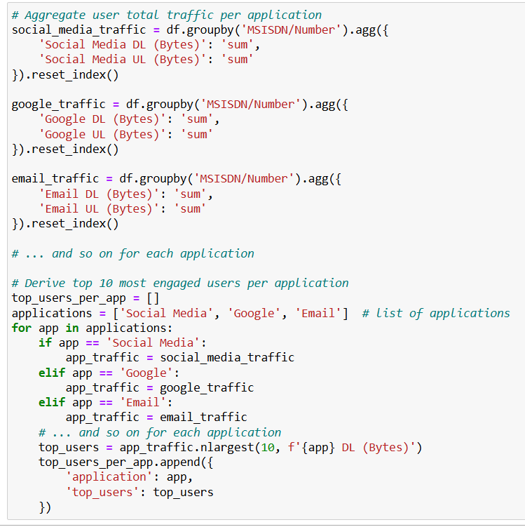

Slide 13
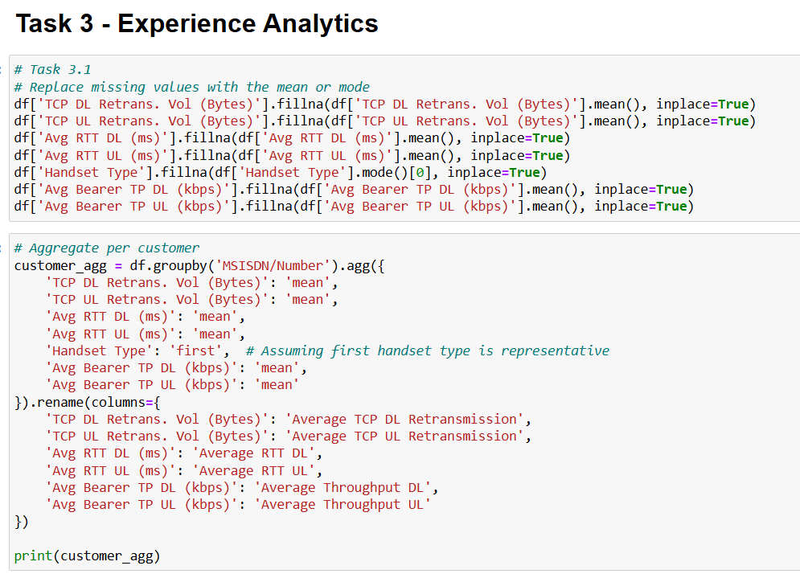

Slide 14
User Experience Analysis
Network Parameters & Handset Characteristics: Average TCP retransmission, RTT, throughput distributions, and their implications.
Experience Clustering: Description and visualization of user experience clusters.
Satisfaction Analysis
Engagement and Experience Scores: Computation and visualization of scores.
Regression Model for Satisfaction Prediction: Overview and key findings.
K-means Clustering and Final Scores Aggregation: Cluster descriptions and average satisfaction per cluster.
Data Export & Model Deployment: Screenshots and details on MySQL export and model tracking using Docker or MlOps tools.

Slide 15
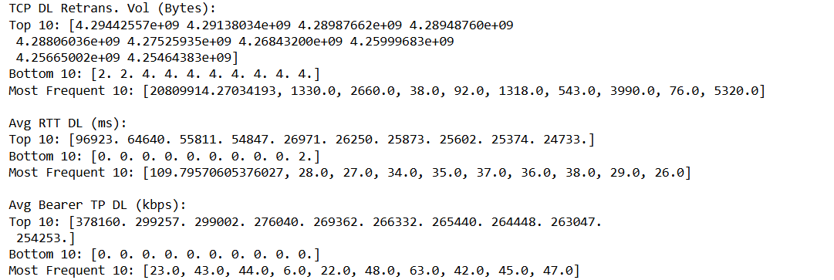
Compute & list 10 of the top, bottom, and most frequent TCP, RTT, Throughput values

Slide 16
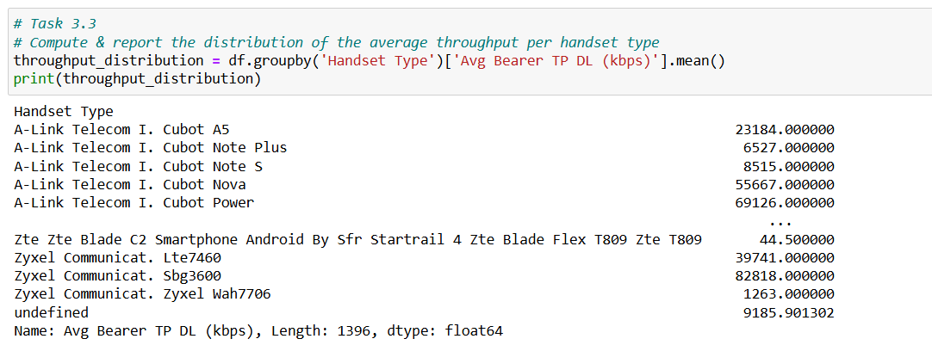
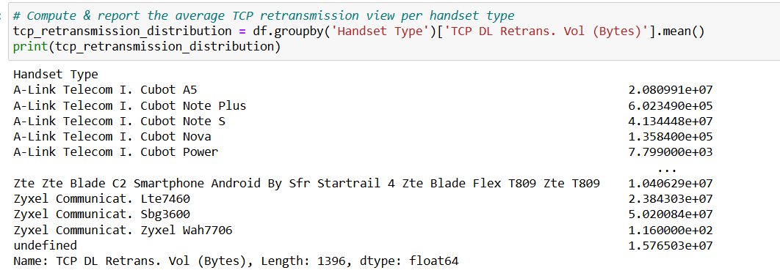

Slide 17
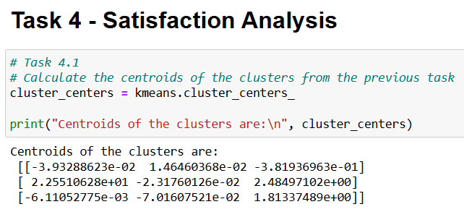
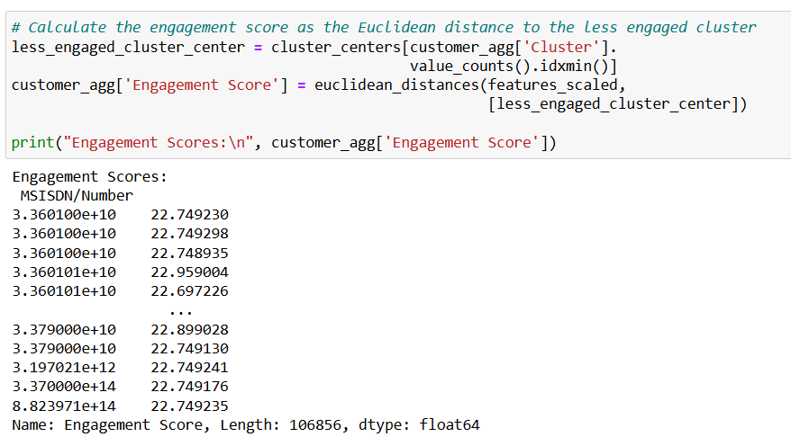

Slide 18
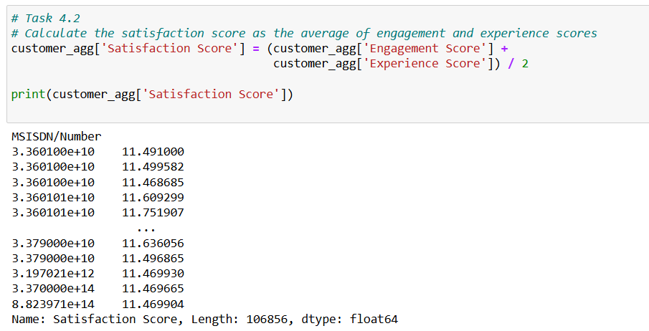
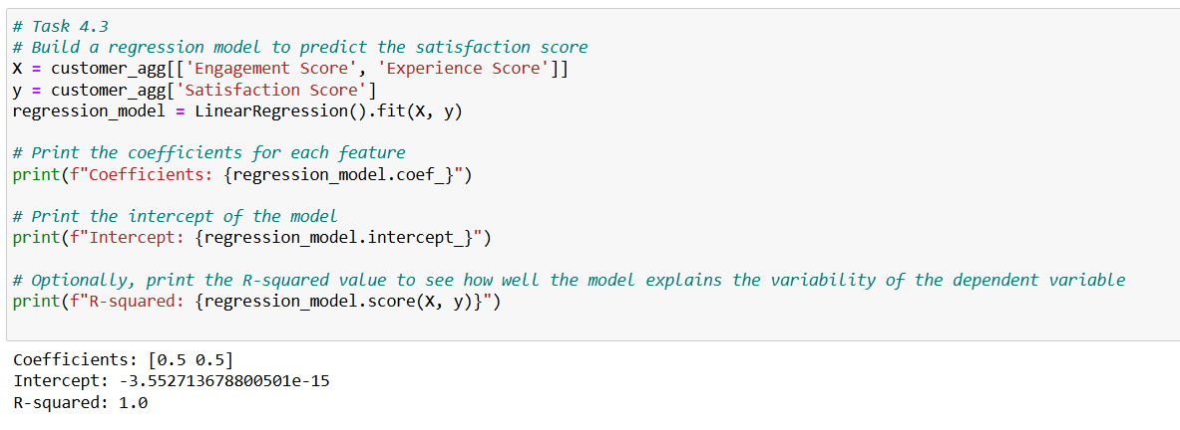

Slide 19
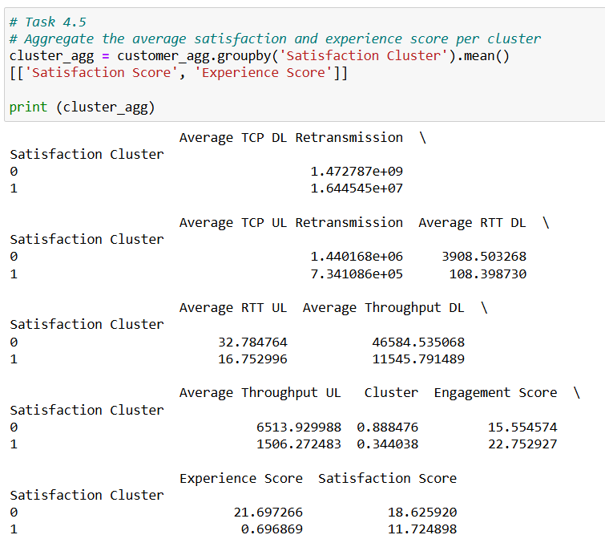

Slide 20
Conclusion:
Key Recommendations
Marketing: Focus on the top handset brands and popular applications for tailored promotions.
Technical Teams: Optimize network resources based on engagement and experience clusters.
Customer Service: Address users with lower satisfaction scores to improve retention and service quality.
This structured approach facilitates a deep dive into telecom user behavior, enabling actionable insights for improving customer satisfaction and business performance.

